Slide 1
KK Box Churn Prediction
Group 2 Deborah Kewon,Daniela Tuiran, Saeed Mirzaee

Slide 2

KKBOX is ASIA's leader subscription-based music streaming service.
When users signs up for the service, they can choose to either manually renew or auto-renew the service. Users can actively cancel their membership at any time.
Predict whether a user will churn after his/her subscription expires.
Forecast if a user subscribes again within 30 days of subscription expiration.
is_churn = 1 churn,
is_churn = 0 renewal.

Slide 3
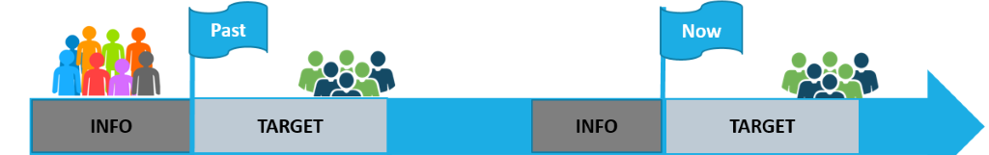
Data
Transactions: Transactions of users up until 3/31/2017, multiple transactions per user
User logs:daily user logs describing listening behaviors of a user.
Members: user information.
Suscription expires March 2017
User churn or renewal roughly in the month of April 2017

Slide 4
Data preparation

Slide 5
User logs
By User ID
nbr_logs
last_log = max(date)
Mean of (num_25,num_50, num_75, num_985, num_100, num_unq, total_secs)

Slide 6
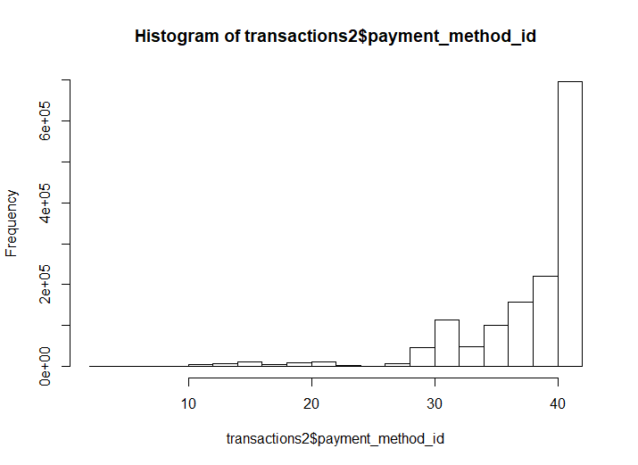
Transactions
autorenew_&_not_cancel: auto_renew = 1 and is_cancel = 0
notAutorenew_&_cancel: auto_renew = 0 and is_cancel = 1
pay_dif = Plan_list_price - actual_amount_paid
Max transaction date
Max expiration date
Is_discount
Dummy variables for payment method
Number of cancels
Number of transactions

Slide 7
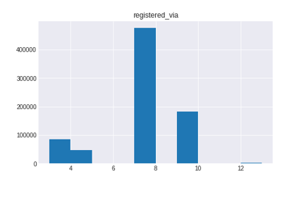
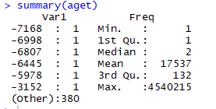
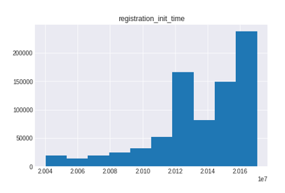
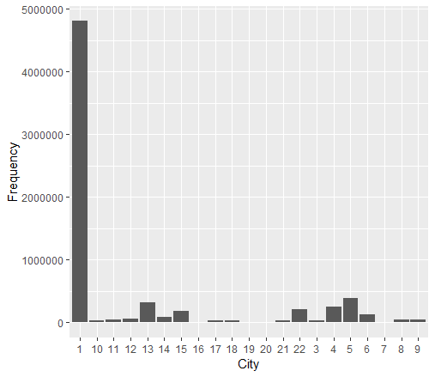
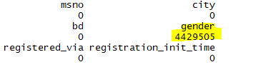
Members
No Duplicates in Members
4,429,505 missing values in gender variable were assigned as '0' to gain more in-depth insights; dummies were created
More than 95% of users are from city 1; the rest of cities are assigned as '0'
Registration_init_time =1970 values were deleted
Negative and extraodinary ages were deleted

Slide 8

Transactions
Members
User logs
Users with no demographic information
New Variables
LOS: Max(expire_date) - reg_initial_date
Start time: Number of days the user takes to start using the service since the initial registration date
Number of renewals
Final Basetable
725.671 Observations (subset-10%)
79 variables

Slide 9
Experimental setting

Slide 10
Data partition
Base table
725,500 observations
79 variables
Train
70% of the data
50,750 obs
Test
30% of the data
21,750 obs
0 | 1
0.93 | 0.07
0 | 1
0.93 | 0.07
0 | 1
0.93 | 0.07

Slide 11
Models

Slide 12
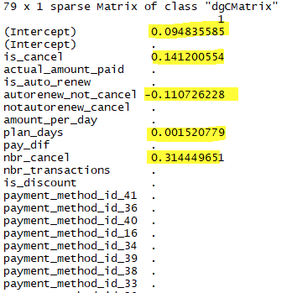
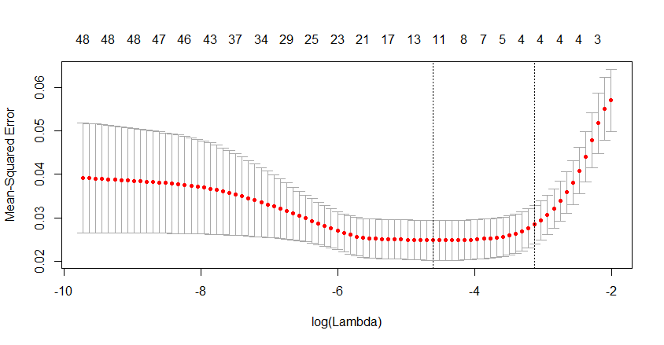
Logistic Regression based on the Lasso
Based on the Lasso, we selected the variables with non-zero coefficients as follows: is_cancel, autorenew_not_cancel, plan_days, and nbr_cancel
We used the glm function in R to run the logistic regression
AUC: 85.60

Slide 13
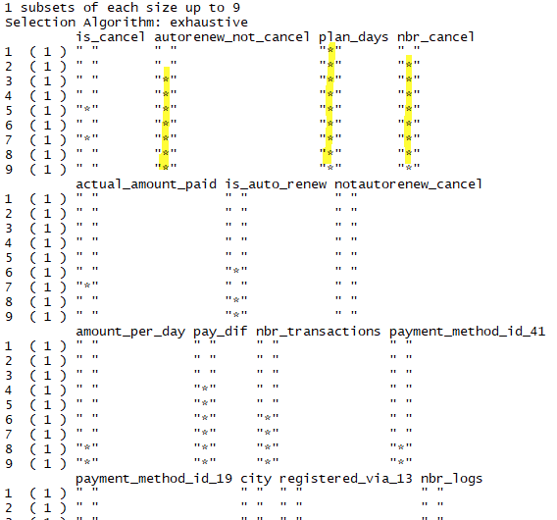
Logistic Regression based on the best subset selection
Based on the best subset selection, we selected the variables with the most significance as follows: autorenew_not_cancel, plan_days, and nbr_cancel
We used the glm function in R to run the logistic regression
AUC: 85.61
In terms of accuracy, there is not a huge difference between using the lasso and using the best subset selection

Slide 14

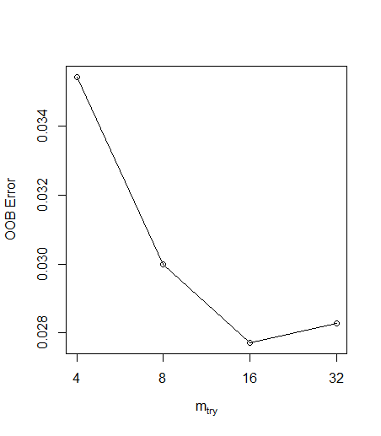
Random Forest
Search for the optimal value of mtry (Number of variables randomly sampled at each split)
Step factor: 2
Number of trees: 150
Notes:
Starting with the default value of mtry, search for the optimal value (with respect to Out-of-Bag error estimate) of mtry for randomForest.

Slide 15
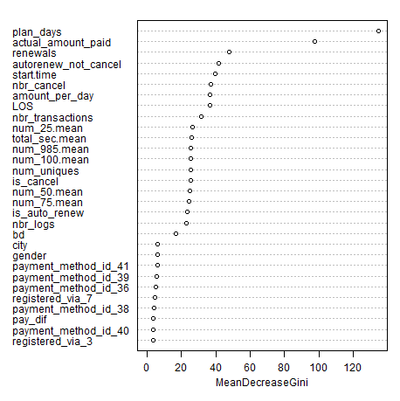
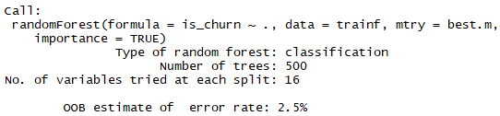
Random Forest results

Slide 16
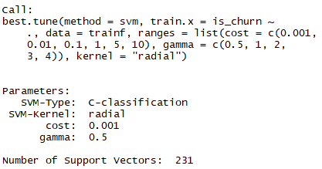
Support Vector Machine
Radial kernel
Cross Validation
γ is a positive constant. (0.5, 1, 2, 3, 4)
Cost (0.001, 0.01, 0.1, 1, 5, 10)
Notes:
#In the former case we also use the degree argument to specify a degree for the polynomial
#kernel, and in the latter case we use gamma to specify a
#value of γ for the radial basis kernel

Slide 17
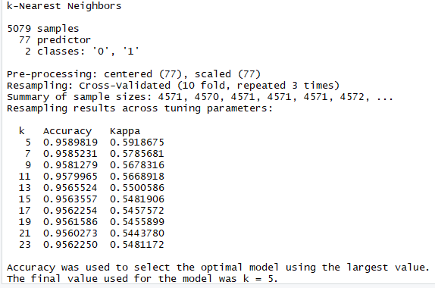
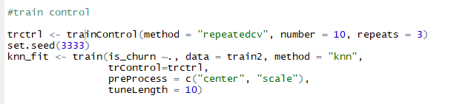
KNN

Slide 18
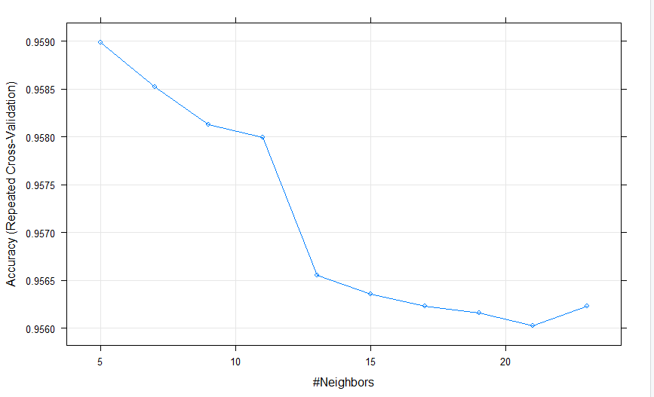
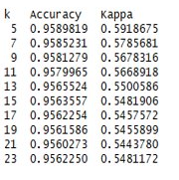
Training Model The accuracy of model is decreasing by increasing the number of neighbors; the optimal number is 5

Slide 19
Benchmarking

Slide 20
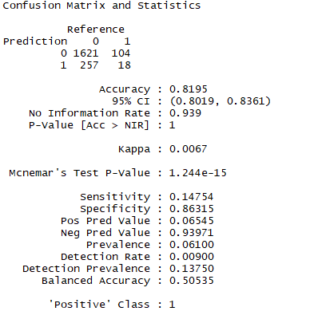
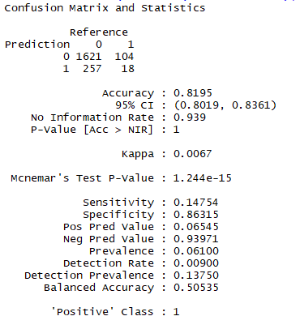
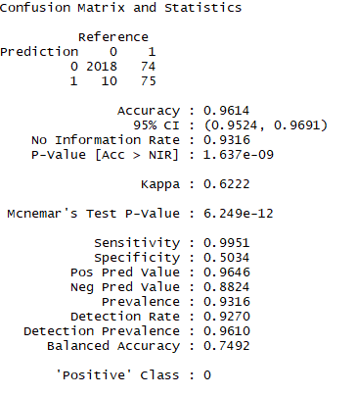
Confusion Matrix
Logistic Regression (The Lasso)
Logistic Regression (Best Subset Selection)
KNN
(using cross validation)
Notes:
The lasso used 2 more variables than best subset when modeling – no difference in accuracy

Slide 21
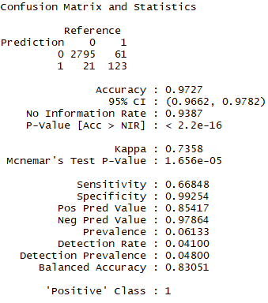
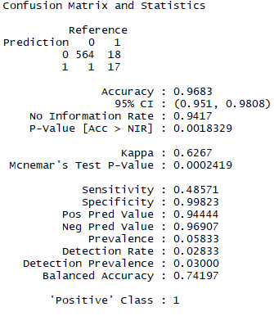
Confusion Matrix
Random Forest
SVM Radial

Slide 22
ROC and AUC
Logistic Regression | Random Forest | SVM Radial | KNN
0.85 | 0.83 | 0.5 | 0.724

Slide 23
Limitations and improvements
Computing times (725671 obs)
Inbalanced response variable: Since only 6% of users churned in the trainset (a lot of 0's), AUC can be quite high
Memory and Ram Limit (ex. Error: cannot allocate vector of size 1922.5 Gb)
Because target variables are in order (first half=0, second half=1; not mixed), we kept getting an error message-"Reordering variables and trying again:"
Numerous features have outliers:
Birthday -> 1000 yrs old user
Total secs: negative value
Date: beyond the scope
Gender: missing info
Possibility to perform cross-validation to evaluate the model performance on different subset of the training data

Slide 24
Questions?

